Slide 1
GOOD MORNING!

Slide 2
PRAYER.
Let’s start our class discussion by asking guidance from the Lord.

Slide 3
SING WITH ME!

Slide 4


Slide 5
Why is it important to know the proper way of conducting physical activities and exercise?

Slide 6
Safety and Proper etiquette in Performing Exercise.
Mr. Prince Leonard P. Suatin

Slide 7
TABLE OF CONTENTS
01
02
03
Explain what is Physical
Activity Readiness
Questionnaire (PAR-Q)
Discuss the three
(3) components of
exercise.
Discuss the Etiquette and Proper Handling of
Equipment and Facilities in Exercises.

Slide 8
01
S A F E
S – SAFETY SHOULD BE
A - APPLIED
F - FREQUENTLY IN
E - EXERCISE

Slide 9
01
What is Physical Activity Readiness Questionnaire (PAR-Q)
It is the one tool that we can use to assess whether a person is capable of doing certain physical activities.

Slide 10
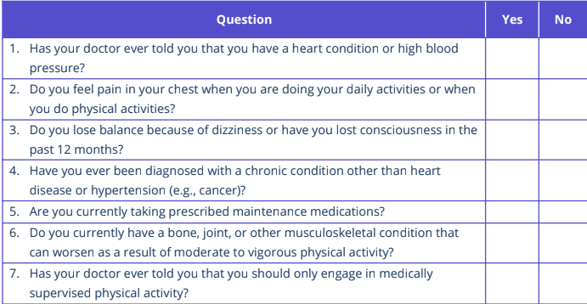

Slide 11
02
THREE (3) COMPONENTS OF EXERCISE.
WARM UP
RECOVERY
COOLDOWN

Slide 12
WARM-UP
Is essential before the actual workload, as it prepares the body for more strenuous activity. It increases blood flow to the working muscles without an abrupt increase in lactic acid accumulation.

Slide 13
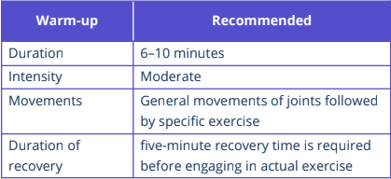
FREQUENCY
Is defined as the number

Slide 14
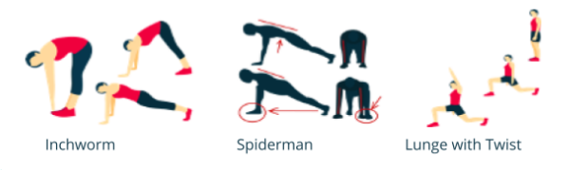
WARM-UP

Slide 15
RECOVERY
I can even be considered as essential as
the main exercise. It is required
because at this time, the body will
begin to make anatomical changes that
are necessary for adaptation.

Slide 16
COOL DOWN
It is the transition between
working out and resting phase. This
transition is necessary to prevent
blood from pooling in the lower
limbs.

Slide 17
Etiquette and Proper Handling of Equipment and Facilities in Exercises.
03

Slide 18
Etiquette and Proper Handling of Equipment and Facilities in Exercises.
03
1. Make sure that the equipment and facilities that you are going to use are essential. It is important to use the correct equipment and to make sure it is in good condition.

Slide 19
03
Etiquette and Proper Handling of Equipment and Facilities in Exercises.
2. When using weights, return the
equipment to its respective place.
Do not wear open-toed shoes or go
barefoot in the weights area.

Slide 20
03
Etiquette and Proper Handling of Equipment and Facilities in Exercises.
3. Proper footwear is important even for people who do not do much exercise. Shoes or boots need to fit well and provide some cushioning.

Slide 21
03
Etiquette and Proper Handling of Equipment and Facilities in Exercises.
4. Look up some of the common sporting injuries and then take a look at the equipment needed to help prevent them.

Slide 22
HOME-BASED ACTIVITY!!

Slide 23
1. REST 2. EAT ON TIME 3. SPEND TIME WITH YOUR FAMILY. 4. TREAT YOURSELF. 5. ENJOY.

